Slide 1
EcoSurvey Analysis
Conor McNamara and Shawn O’Grady

Slide 2
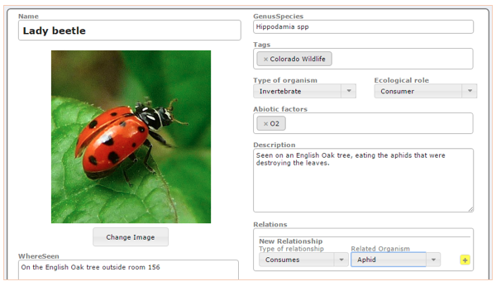
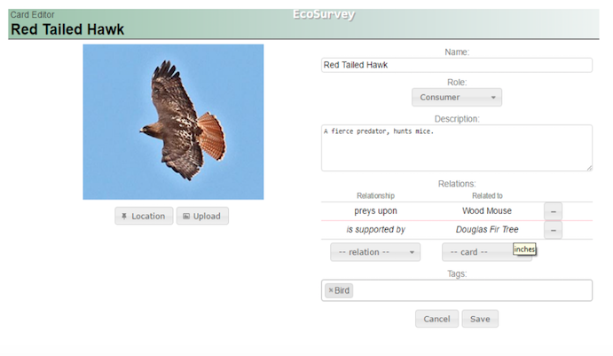
Introduction

Slide 3
Data Set
EcoSurvey Base (mysql)
Found by Conor McNamara from Research Work
Requires Citi Training and authorization to access
Findings for EcoSurvey Version 1
Written by Conor McNamara
Previously stored in an Excel document

Slide 4
Questions
Using object and subject features, can we predict the relationship between the two organisms?
Which features from the data set are the most predictive of relationships?

Slide 5
Process
Data cleaning
Organizing mysql base to get necessary info
Converting to .csv
Converting to .arff
Preprocessing
Using Weka to Preprocess data
Feature Selection/Analysis
Using Weka to determine predictive features
Classification
Using Weka to run classification algorithms of various types
Error Analysis
Observing Confusion Matrices

Slide 6
Tools Used
GitHub
Mysql
Microsoft Excel
Python
Sublime
Weka
Microsoft Word

Slide 7
Algorithms Applied
Classification Algorithms:
Random Forest
Naive Bayes
Feature Selection Algorithms:
Information Gain Based

Slide 8
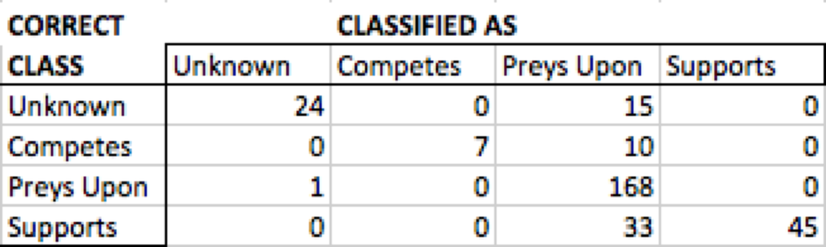
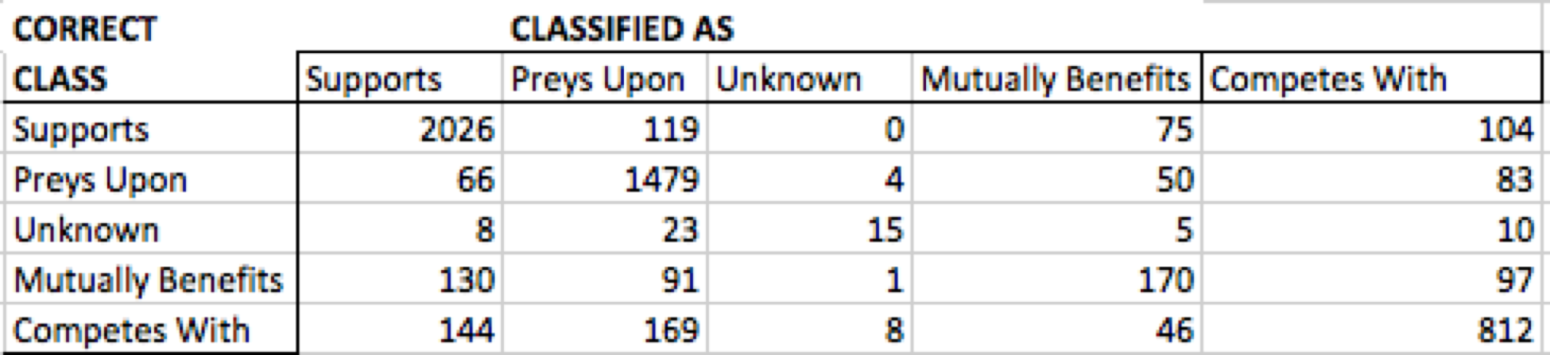
Results
Version 1:
80%
Version 2:
78%

Slide 9
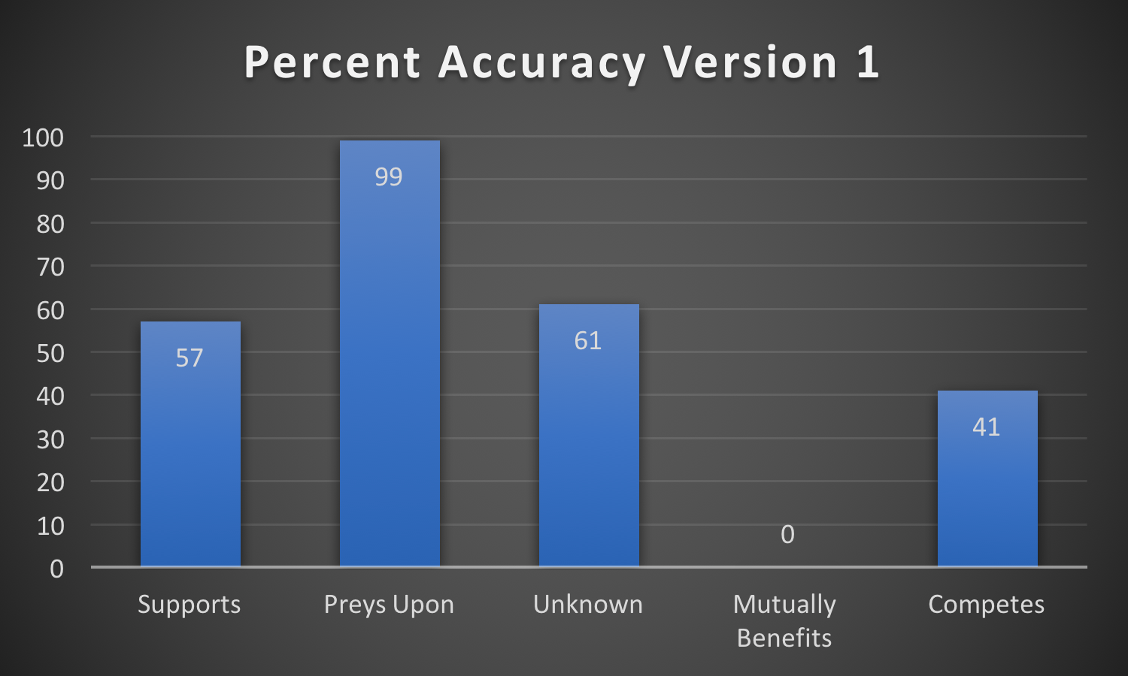
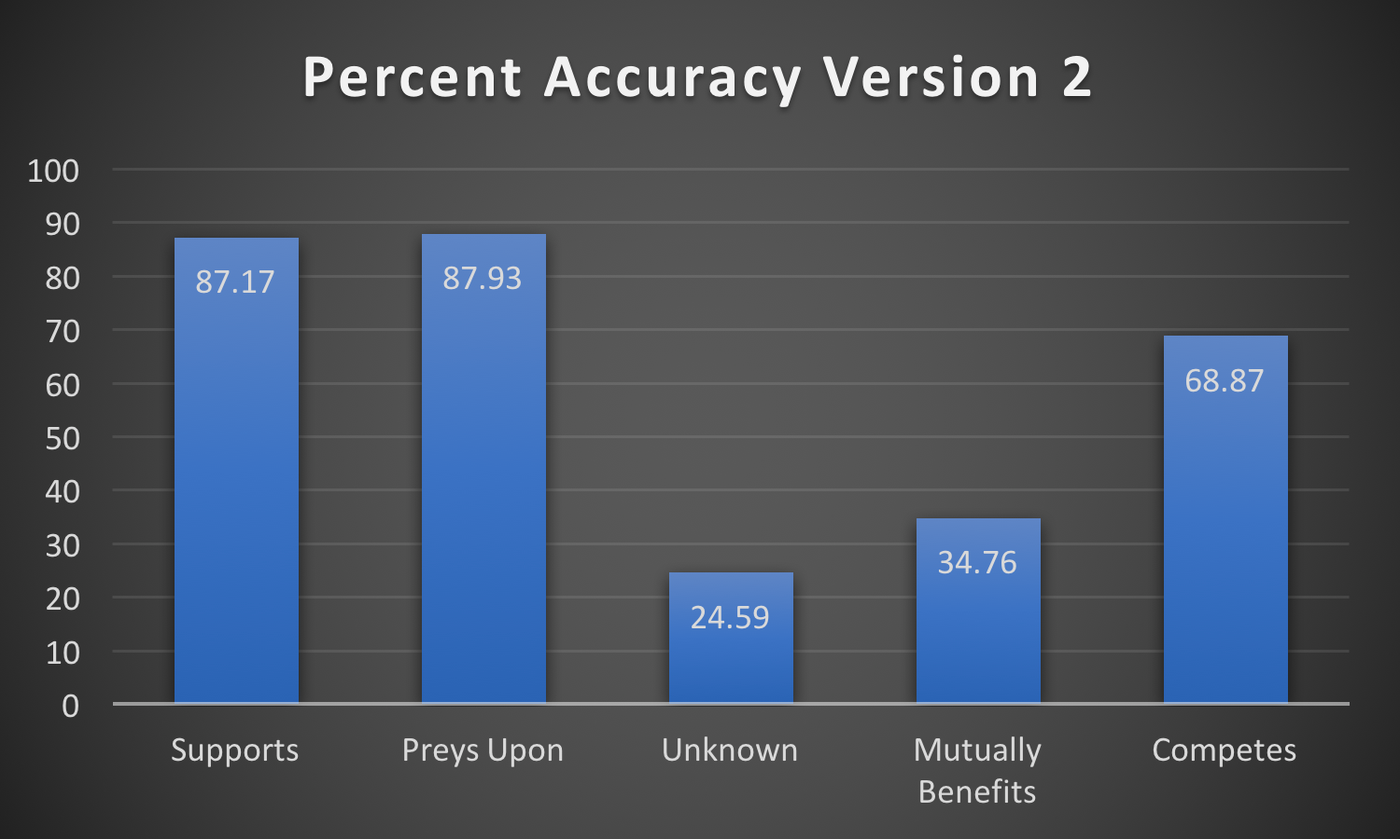
Results Continued

Slide 10
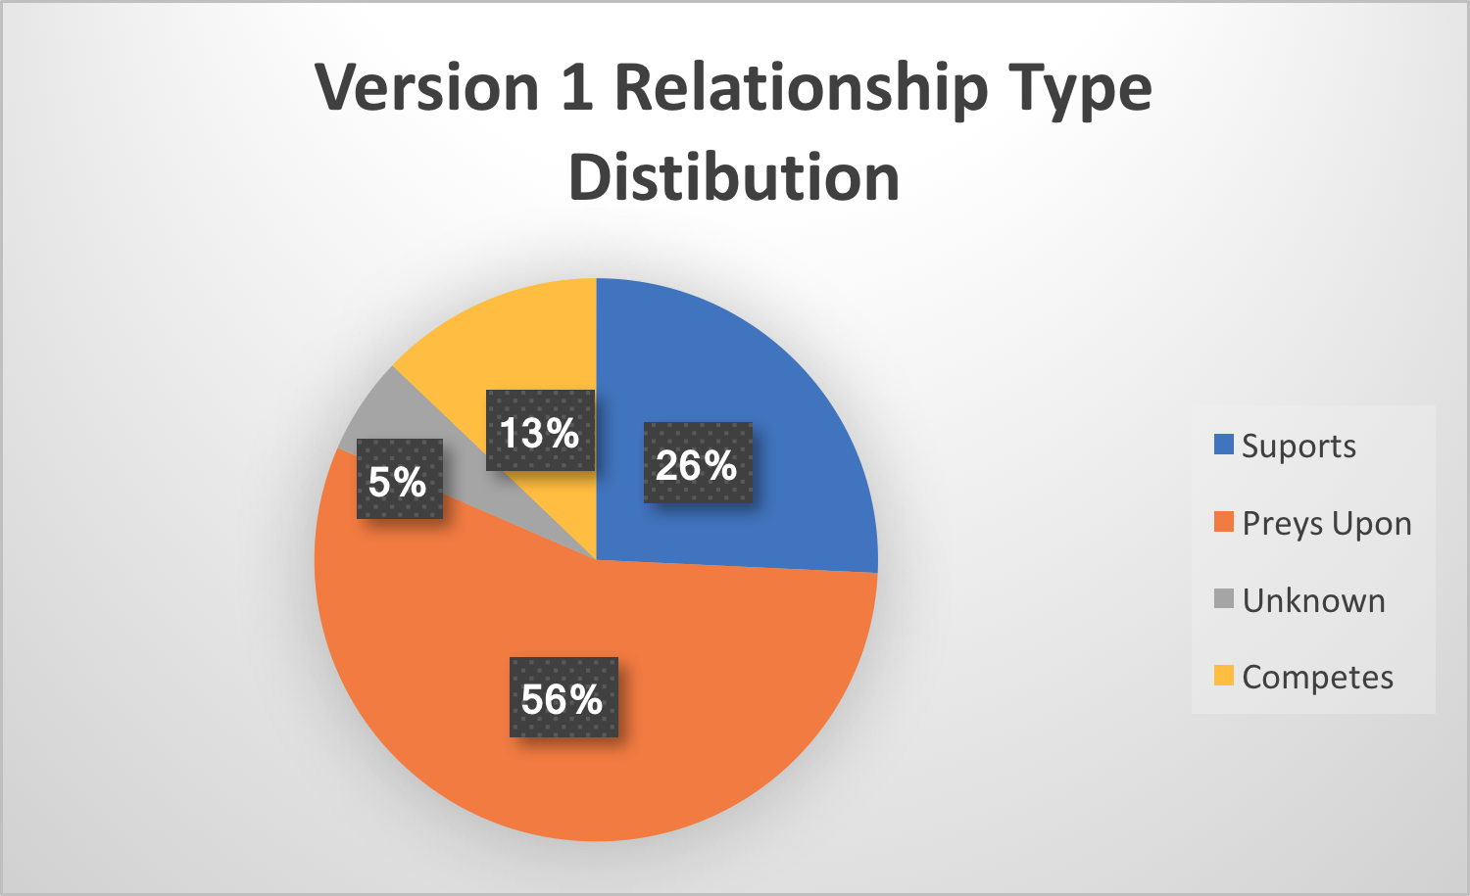
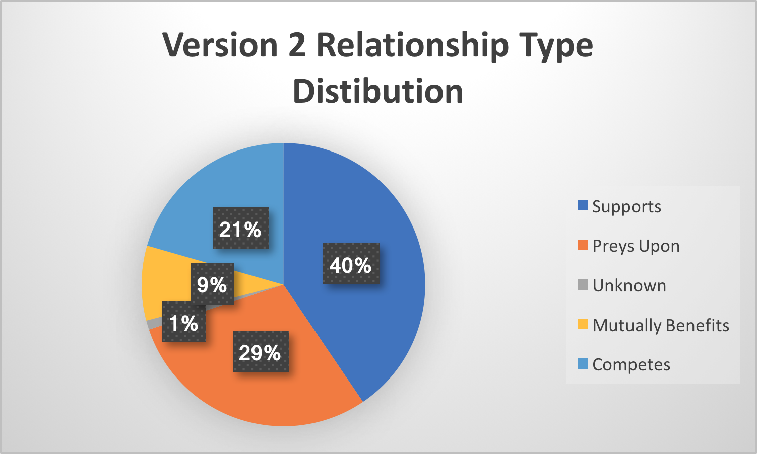
Results Continued

Slide 11
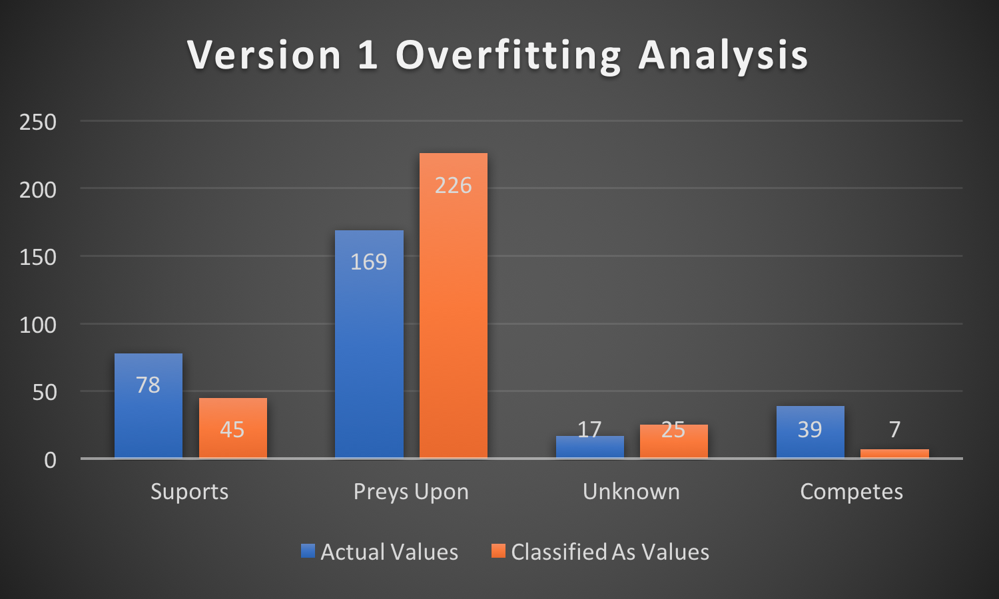
Results Continued

Slide 12
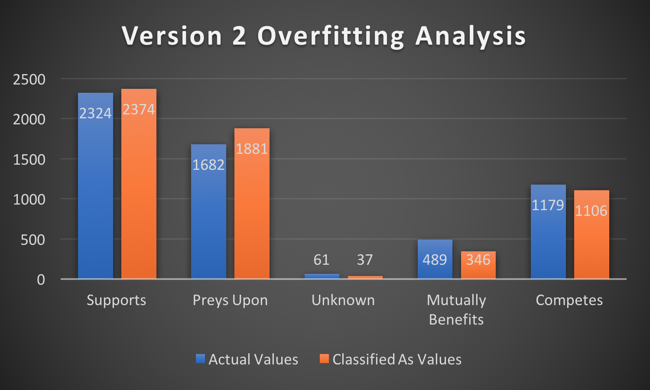
Results Continued

Slide 13
Application
For future student scientific model applications, user interaction can be increased by:
Using closed text fields
More prominent relationship graphs
More directly, these results will influence the next version of EcoSurvey
Also knowing which features of organisms were most predictive, future versions of EcoSurvey can be built with less unnecessary data

Slide 14
The End

